Slide 1
Device Control: Removable Storage
This demo is via GPO, please keep in mind the Intune OMA-URI policy is a little bit different: Microsoft Defender for Endpoint Device Control Removable Storage Access Control | Microsoft Docs

Slide 2
Device installation
Step 1: Block USBs installations but allow specific approved USBs – Device installation
Step 2: for approved USBs, Block Write and Execute/ReadOnly except secure USBs, e.g. Ironkey/BitLocker encrypted USBs
Step 3: for the encrypted USBs, only allow specific User use on specific machine
Step 4: audit all the events
Block events
Allowed events
Removable Storage Access Control

Slide 3
Design Removable Storage Groups based on the scenarios
‘Non-approved USB’ group: Block installation
‘Secure USB with partial access’ group: block Read or Write or Execute or All
‘Allowed for specific User AND Machine’ group: USBs in this will only allow specific user on specific machine
USB Group | Class GUID (Block property) | Instance Id (Allow property) | Hardware Id (Allow property) | VID/PID
Non-approved USB | {36fc9e60-c465-11cf-8056-444553540000} {88BAE032-5A81-49f0-BC3D-A4FF138216D6} | USBSTOR\DISK&VEN_GENERIC-&PROD_USB3.0_CRW____-0&REV_1.00\201006010301&0 USBSTOR\DISK&VEN_GENERIC-&PROD_USB3.0_CRW____-1&REV_1.00\201006010301&1 USBSTOR\DISK&VEN_GENERIC-&PROD_USB3.0_CRW____-2&REV_1.00\201006010301&2 | USBSTOR\DiskGeneric-USB3.0_CRW____-01.00 USBSTOR\DiskGeneric-USB3.0_CRW____-11.00 USBSTOR\DiskGeneric-USB3.0_CRW____-21.00 | VID_9570&PID_0301\
Secure USB with partial access |  | USBSTOR\DISK&VEN_GENERIC&PROD_FLASH_DISK&REV_8.07\B7A8BCDE&0 | USBSTOR\DiskGeneric_Flash_Disk______8.07 | VID_058F&PID_6387
Approved USB |  | USBSTOR\DISK&VEN_SAMSUNG&PROD_FLASH_DRIVE&REV_1100\0306819040006829&0 | USBSTOR\DiskSamsung_Flash_Drive_____1100 | VID_090C&PID_1000
Approved USB |  | USBSTOR\DISK&VEN_GENERIC&PROD_FLASH_DISK&REV_8.07\8735B611&0 | USBSTOR\DiskGeneric_Flash_Disk______8.07 | VID_058F&PID_6387
Allowed for specific User AND Machine |  | USBSTOR\DISK&VEN__USB&PROD__SANDISK_3.2GEN1&REV_1.00\03003324080520232521&0 | USBSTOR\Disk_USB_____SanDisk_3.2Gen11.00 | VID_0781&PID_5597
Notes:
{36fc9e60-c465-11cf-8056-444553540000}
{88BAE032-5A81-49f0-BC3D-A4FF138216D6}

Slide 4
Step 1: Block USBs installations but allow specific approved USBs
Ignore this for now, we will publish more detail once we finish backporting
Block Removable storage classes
Allow approved USBs (‘Allowed for specific User AND Machine’ and ‘Secure USB with partial access’ groups below) based on Instance ID or Device ID
USB Group | Class GUID (Block property) | Instance Id (Allow property) | Hardware Id (Allow property) | VID/PID | Step 1 Result
Non-approved USB | {36fc9e60-c465-11cf-8056-444553540000} {88BAE032-5A81-49f0-BC3D-A4FF138216D6} | USBSTOR\DISK&VEN_GENERIC-&PROD_USB3.0_CRW____-0&REV_1.00\201006010301&0 USBSTOR\DISK&VEN_GENERIC-&PROD_USB3.0_CRW____-1&REV_1.00\201006010301&1 USBSTOR\DISK&VEN_GENERIC-&PROD_USB3.0_CRW____-2&REV_1.00\201006010301&2 | USBSTOR\DiskGeneric-USB3.0_CRW____-01.00 USBSTOR\DiskGeneric-USB3.0_CRW____-11.00 USBSTOR\DiskGeneric-USB3.0_CRW____-21.00 | VID_9570&PID_0301\ | Blocked
Secure USB with partial access | {4d36e967-e325-11ce-bfc1-08002be10318} | USBSTOR\DISK&VEN_GENERIC&PROD_FLASH_DISK&REV_8.07\B7A8BCDE&0 | USBSTOR\DiskGeneric_Flash_Disk______8.07 | VID_058F&PID_6387 | Allowed by hardware Id
Approved USB | {4d36e967-e325-11ce-bfc1-08002be10318} | USBSTOR\DISK&VEN_SAMSUNG&PROD_FLASH_DRIVE&REV_1100\0306819040006829&0 | USBSTOR\DiskSamsung_Flash_Drive_____1100 | VID_090C&PID_1000 | Allowed by hardware Id
Approved USB | {4d36e967-e325-11ce-bfc1-08002be10318} | USBSTOR\DISK&VEN_GENERIC&PROD_FLASH_DISK&REV_8.07\8735B611&0 | USBSTOR\DiskGeneric_Flash_Disk______8.07 | VID_058F&PID_6387 | Allowed by hardware Id
Allowed for specific User AND Machine | {4d36e967-e325-11ce-bfc1-08002be10318} | USBSTOR\DISK&VEN__USB&PROD__SANDISK_3.2GEN1&REV_1.00\03003324080520232521&0 | USBSTOR\Disk_USB_____SanDisk_3.2Gen11.00 | VID_0781&PID_5597 | Allowed by instance Id

Slide 5
Step 2: for approved USBs, Block WE/ReadOnly except secure USBs, e.g. Ironkey/BitLocker encrypted USBs
Block Read/Write/Execute but allow secure USBs
For the allowed, Block Write and Execute or Block Execute but exclude the USB allowed by specific user AND machine
USB Group | Class GUID (Block property) | Instance Id (Allow property) | Hardware Id (Allow property) | VID/PID | Step 1 Result
Non-approved USB | {36fc9e60-c465-11cf-8056-444553540000} {88BAE032-5A81-49f0-BC3D-A4FF138216D6} | USBSTOR\DISK&VEN_GENERIC-&PROD_USB3.0_CRW____-0&REV_1.00\201006010301&0 USBSTOR\DISK&VEN_GENERIC-&PROD_USB3.0_CRW____-1&REV_1.00\201006010301&1 USBSTOR\DISK&VEN_GENERIC-&PROD_USB3.0_CRW____-2&REV_1.00\201006010301&2 | USBSTOR\DiskGeneric-USB3.0_CRW____-01.00 USBSTOR\DiskGeneric-USB3.0_CRW____-11.00 USBSTOR\DiskGeneric-USB3.0_CRW____-21.00 | VID_9570&PID_0301\ | Step 1: Blocked installation
Secure USB with partial access | {4d36e967-e325-11ce-bfc1-08002be10318} | USBSTOR\DISK&VEN_GENERIC&PROD_FLASH_DISK&REV_8.07\B7A8BCDE&0 | USBSTOR\DiskGeneric_Flash_Disk______8.07 | VID_058F&PID_6387 | Blocked W/E (ReadOnly) Or Allow Read by instance Id
Approved USB | {4d36e967-e325-11ce-bfc1-08002be10318} | USBSTOR\DISK&VEN_SAMSUNG&PROD_FLASH_DRIVE&REV_1100\0306819040006829&0 | USBSTOR\DiskSamsung_Flash_Drive_____1100 | VID_090C&PID_1000 | Blocked R/W/E
Approved USB | {4d36e967-e325-11ce-bfc1-08002be10318} | USBSTOR\DISK&VEN_GENERIC&PROD_FLASH_DISK&REV_8.07\8735B611&0 | USBSTOR\DiskGeneric_Flash_Disk______8.07 | VID_058F&PID_6387 | Blocked E or Allowed R/W by instance Id
Allowed for specific User AND Machine | {4d36e967-e325-11ce-bfc1-08002be10318} | USBSTOR\DISK&VEN__USB&PROD__SANDISK_3.2GEN1&REV_1.00\03003324080520232521&0 | USBSTOR\Disk_USB_____SanDisk_3.2Gen11.00 | VID_0781&PID_5597 | Exclude from this policy By VID/PID

Slide 6
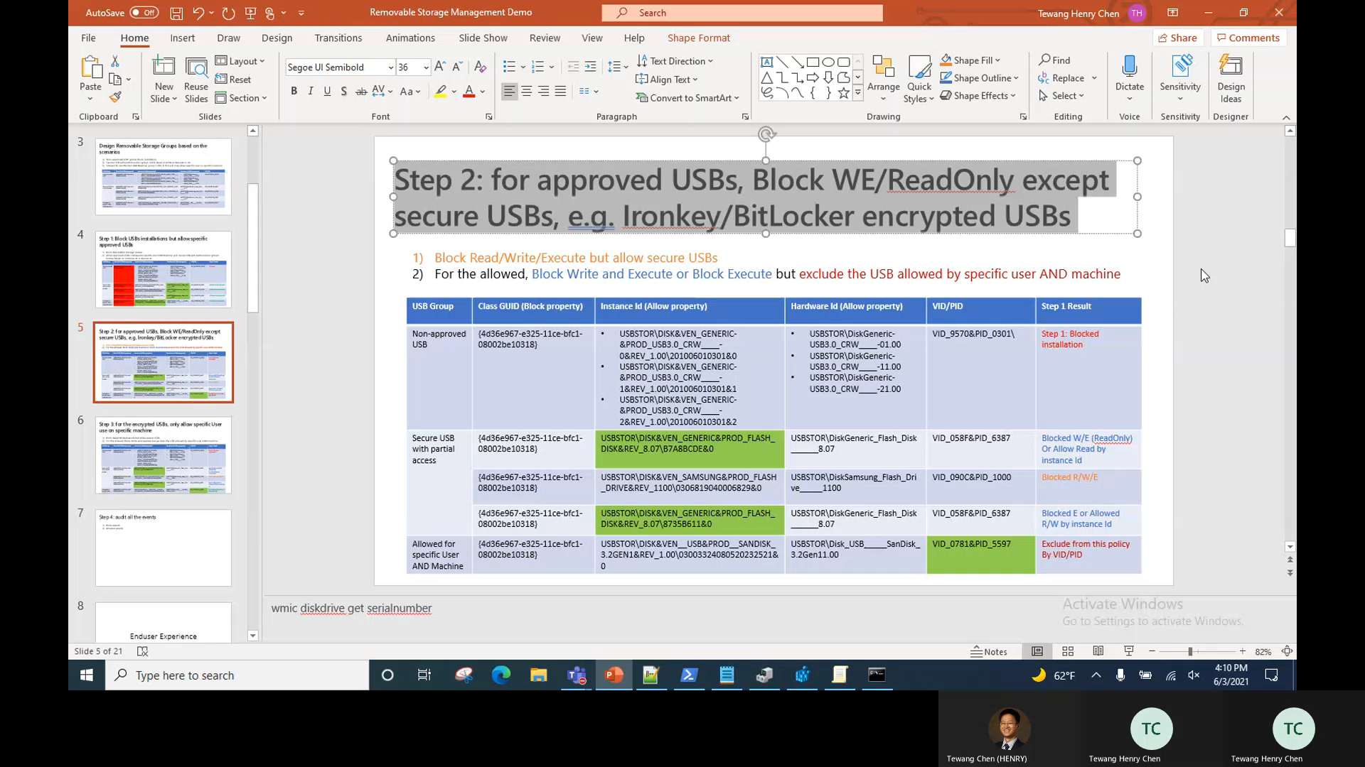
Step 2: for approved USBs, Block WE/ReadOnly except secure USBs, e.g. Ironkey/BitLocker encrypted USBs

Slide 7
Step 3: for the encrypted USBs, only allow specific User use on specific machine
Block Read/Write/Execute but allow secure USBs
For the allowed, Block Write and Execute but exclude the USB allowed by specific user AND machine
USB Group | Class GUID (Block property) | Instance Id (Allow property) | Hardware Id (Allow property) | VID/PID | Step 1 Result
Non-approved USB | {36fc9e60-c465-11cf-8056-444553540000} {88BAE032-5A81-49f0-BC3D-A4FF138216D6} | USBSTOR\DISK&VEN_GENERIC-&PROD_USB3.0_CRW____-0&REV_1.00\201006010301&0 USBSTOR\DISK&VEN_GENERIC-&PROD_USB3.0_CRW____-1&REV_1.00\201006010301&1 USBSTOR\DISK&VEN_GENERIC-&PROD_USB3.0_CRW____-2&REV_1.00\201006010301&2 | USBSTOR\DiskGeneric-USB3.0_CRW____-01.00 USBSTOR\DiskGeneric-USB3.0_CRW____-11.00 USBSTOR\DiskGeneric-USB3.0_CRW____-21.00 | VID_9570&PID_0301\ | Step 1: Blocked installation
Secure USB with partial access | {4d36e967-e325-11ce-bfc1-08002be10318} | USBSTOR\DISK&VEN_GENERIC&PROD_FLASH_DISK&REV_8.07\B7A8BCDE&0 | USBSTOR\DiskGeneric_Flash_Disk______8.07 | VID_058F&PID_6387 | Step 2: Blocked W/E (ReadOnly) Or Allow Read by instance Id
Approved USB | {4d36e967-e325-11ce-bfc1-08002be10318} | USBSTOR\DISK&VEN_SAMSUNG&PROD_FLASH_DRIVE&REV_1100\0306819040006829&0 | USBSTOR\DiskSamsung_Flash_Drive_____1100 | VID_090C&PID_1000 | Step 2: Blocked R/W/E
Approved USB | {4d36e967-e325-11ce-bfc1-08002be10318} | USBSTOR\DISK&VEN_GENERIC&PROD_FLASH_DISK&REV_8.07\8735B611&0 | USBSTOR\DiskGeneric_Flash_Disk______8.07 | VID_058F&PID_6387 | Step 2: Blocked E or Allowed R/W by instance Id
Allowed for specific User AND Machine | {4d36e967-e325-11ce-bfc1-08002be10318} | USBSTOR\DISK&VEN__USB&PROD__SANDISK_3.2GEN1&REV_1.00\03003324080520232521&0 | USBSTOR\Disk_USB_____SanDisk_3.2Gen11.00 | VID_0781&PID_5597 | Allowed by User Sid and Computer Sid
Notes:
cd C:\Users\Henry\Downloads\PSTools
Psgetsid
psgetsid Henry

Slide 8
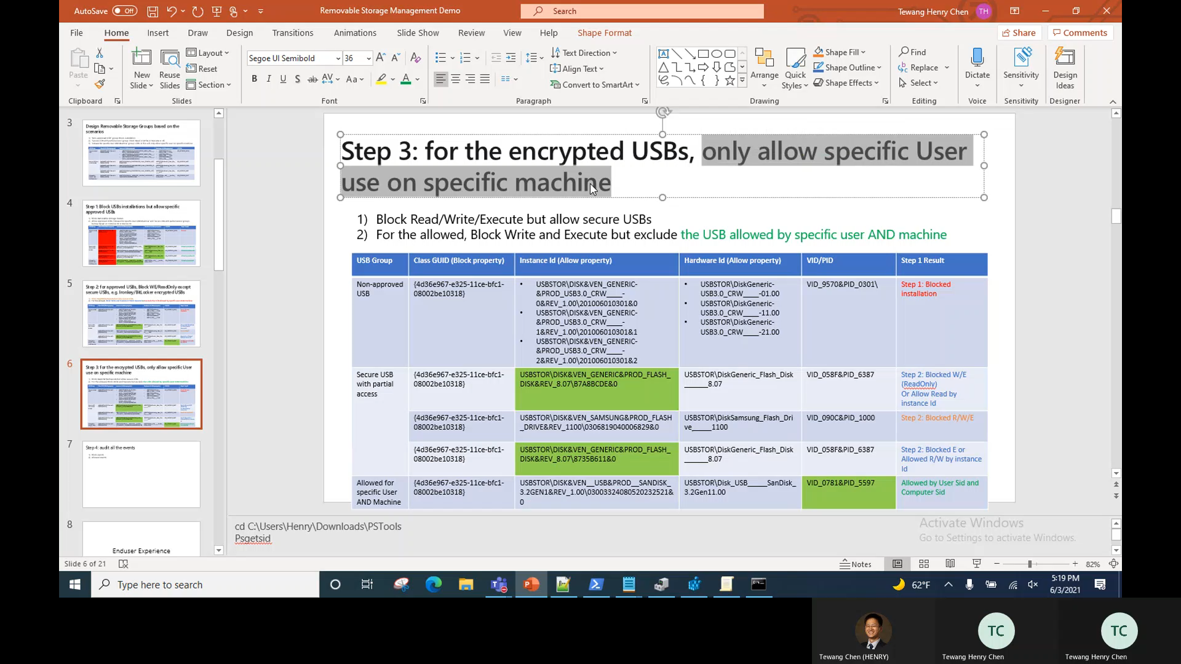
Step 3: for the encrypted USBs, only allow specific User use on specific machine – Demo Video
Notes:
cd C:\Users\Henry\Downloads\PSTools
Psgetsid
psgetsid Henry

Slide 9
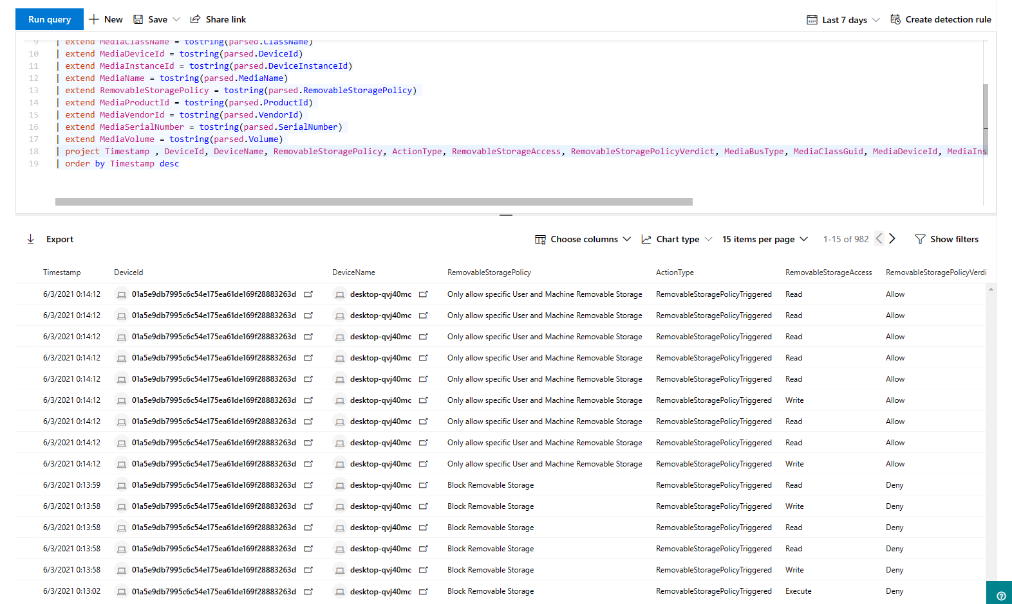
Step 4: audit all the events
Onboard the machine MDE, all the event (audit Allow and audit Deny) is captured in the Advanced Hunting on the Security portal: Microsoft Defender for Endpoint Device Control Removable Storage Access Control | Microsoft Docs

Slide 10
Enduser Experience

Slide 11
Audit/Allow mode
There is no notification on the client side, but in the backend the system will fire event for reporting

Slide 12
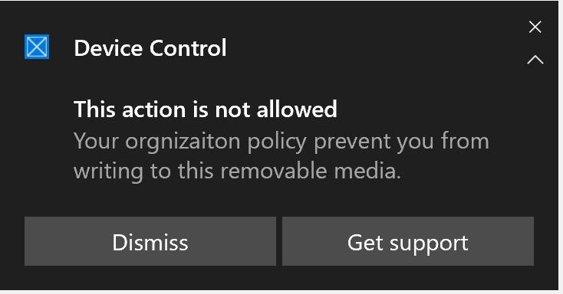
Block mode

Slide 13
Removable Storage Reporting
In progress

Slide 14
End

